Slide 1

Classifying Sale Prices of Homes in Ames, IA
Megan Cusey
Elmhurst College – MDS 556
Fall B 2019

Slide 2
Business Objectives
Objective: Identify homes that sell in the Top 25% of Sale Price in Ames, IA.
Use Cases:
As a realtor who specializes in the selling and purchasing process of only the most luxury homes, use this model to determine homes that meet the requirements inside this niche quickly.
As a real estate developer, identify homes that have the opportunity to sell at the top 25% tier that may currently be under priced
As a real estate developer, identify what features of a home are the most important in the top 25% of homes
Each use case expresses a cost if the model incorrectly identifies a home as a Top 25% house (false positive). As a result, it is required that the selected model optimizes precision.

Slide 3
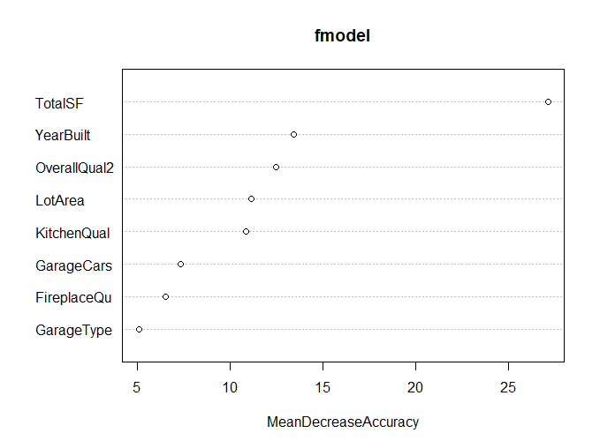
Feature Importance – Random Forest

Slide 4
Decision Tree
Base Rate: 75.3%
Precision Rate: 94.92%
Recall Rate: 96.55%
Out of 202 observations:
168 Bottom 75 homes correctly identified
19 homes correctly identified as top 25 home
9 False Positives
9 False Negatives

Slide 5
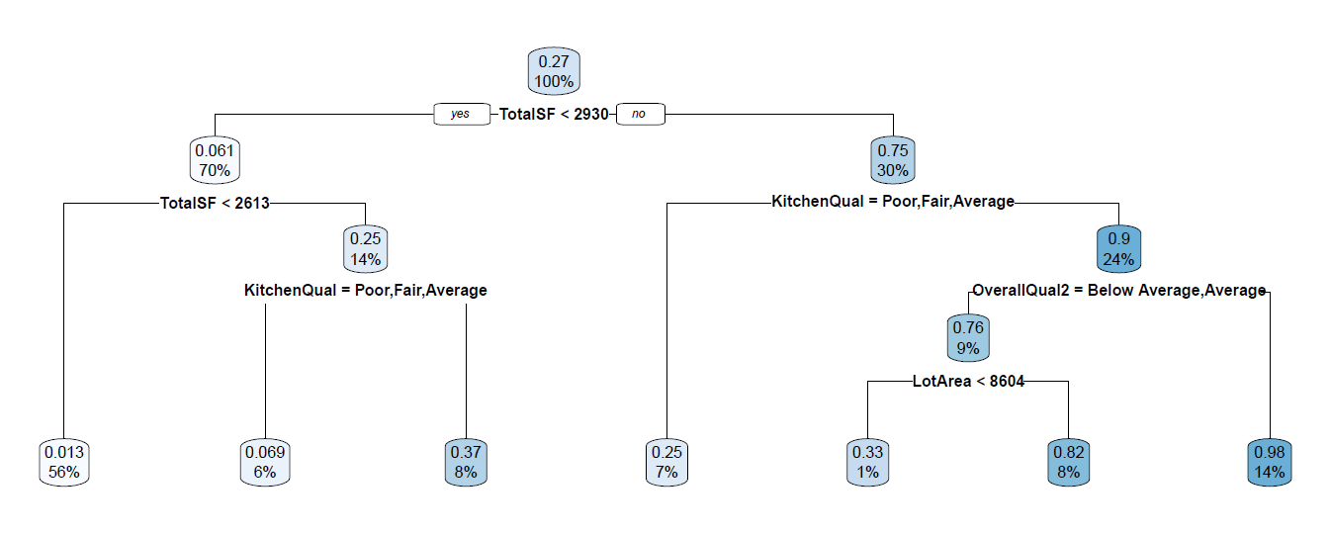
Decision Tree Plot

Slide 6
Decision Tree with Bagging
Base Rate: 75.3%
Precision Rate: 91.59%
Recall Rate: 98.58%
Out of 202 observations:
187 homes correctly identified
10 False Positives
5 False Negatives

Slide 7
Decision Tree- Bagging
Differences between the first decision tree and when bagging was applied:
Split on Square Footage and then Year Built while the original decision tree didn’t split on Year Built.
Split on Fireplace Quality

Slide 8
Next Steps
Optimizing parameters in the classification to maximize precision and recall rate
Reviewing in more detail for overfitting
Perhaps find another way to factor in Neighborhood. It lost it feature importance when put the different neighborhoods into bins.
Fireplace Quality seems to be an odd feature with high importance since many houses do not have a fireplace. I think this feature is correlated with another feature not present in this analysis. Some additional research may uncover a better predictive feature that explains this correlation.

